Slide 2
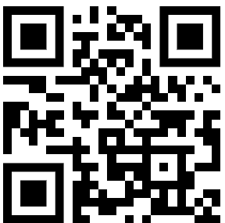
Dr. Damir Dobric
Lead Software Architect daenet GmbH / ACP Digital
Microsoft Regional Director,
Most Valuable Professional: AI+Azure

Slide 3
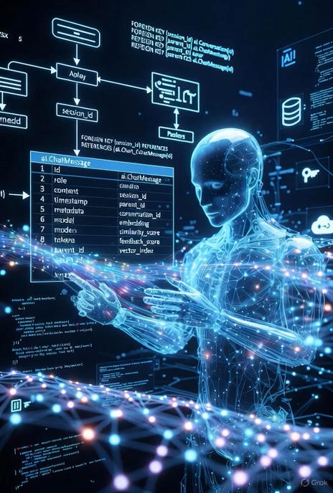

The new Software Era
Robots,
Quantum Computing
. . .
“After tomorrow”
“Tomorrow”
Today
AI & LLM Integration
Syntax Driven Languages

Slide 4




Talking to anything Natural Language -> Software -> Action
AGENT

Slide 5
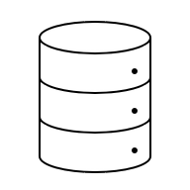
Language to SQL? When the model is trained to Programming Language
AGENT
creates SQL

Slide 6
Putting all together
AGENT
Prompt to SQL Plugin
Lighting
Plugin
xy
Plugin
WhatEver

Slide 7
Model Context Protocol MCP
AGENT
MCP
MCP Server
Prompt to SQL Plugin
MCP Client
MCP
MCP Server Lighting
Plugin
MCP Client
MCP Server xy
Plugin
MCP Client
MCP
WhatEver

Slide 8
Model Context Protocol MCP: Local:stdio or Remote:HttpStream
AGENT
localhost
MCP Server
Prompt to SQL Plugin
MCP Client
MCP
HttpStream
MCP Server Lighting
Plugin
MCP Client
MCP
HttpStream
xy
Plugin
MCP Client
MCPStdio
MCP Server WhatEver

Slide 9
Vibecoding How do we make software today?
Programming Language
Machine Code
compiler

Slide 10
Vibecoding The future?
Natural
Language
Programming Language
compiler
Machine Code
AI
Write on the screen following text: “Hello world”
Console.WriteLine(“Hello world”)

Slide 11
Dr. Damir Dobric
Lead Software Architect daenet GmbH / ACP Digital
Microsoft Regional Director,
Most Valuable Professional: AI+Azure

